Slide 1
540 Hackathon: MAMEwork Arcade
@540mamework • 11.04.2017

Slide 2
Overview
@540mamework
Build a pedestal.
Configure RetroPie.
Document process.
Free Play forever.

Slide 3
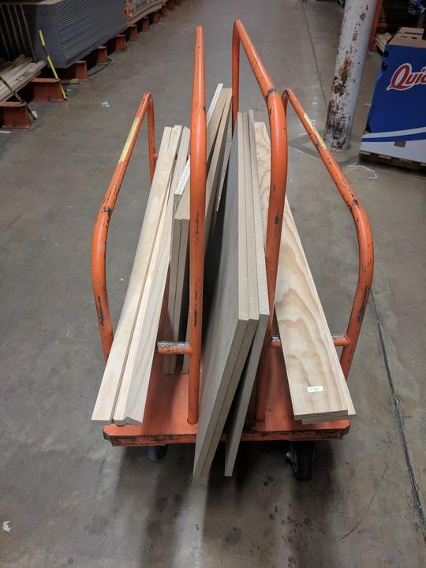
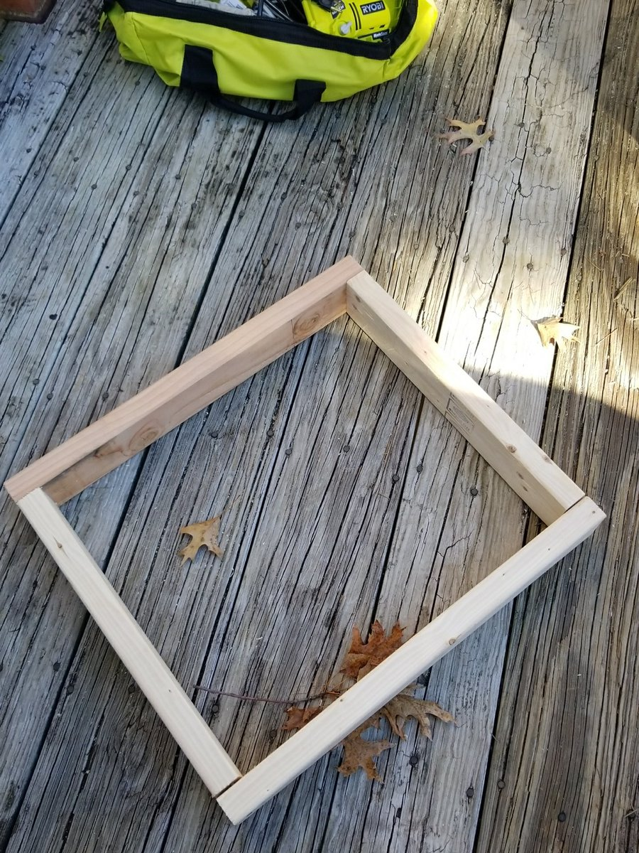
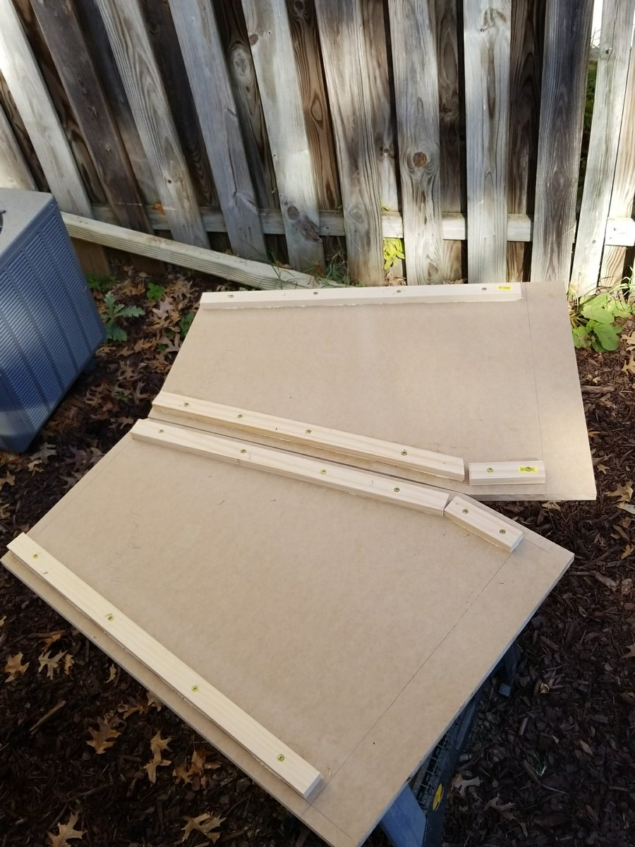
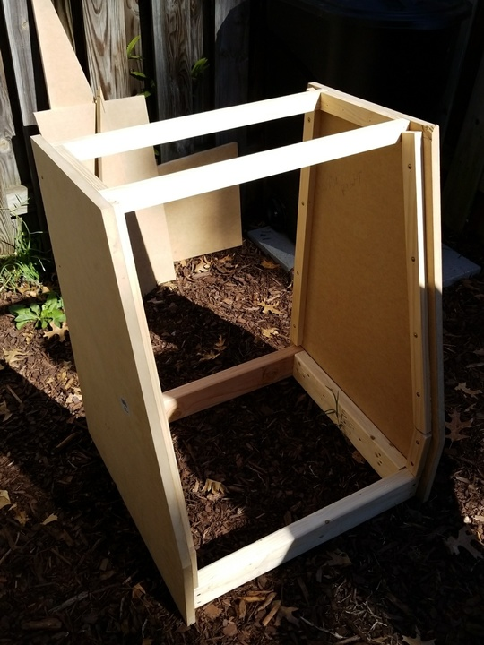
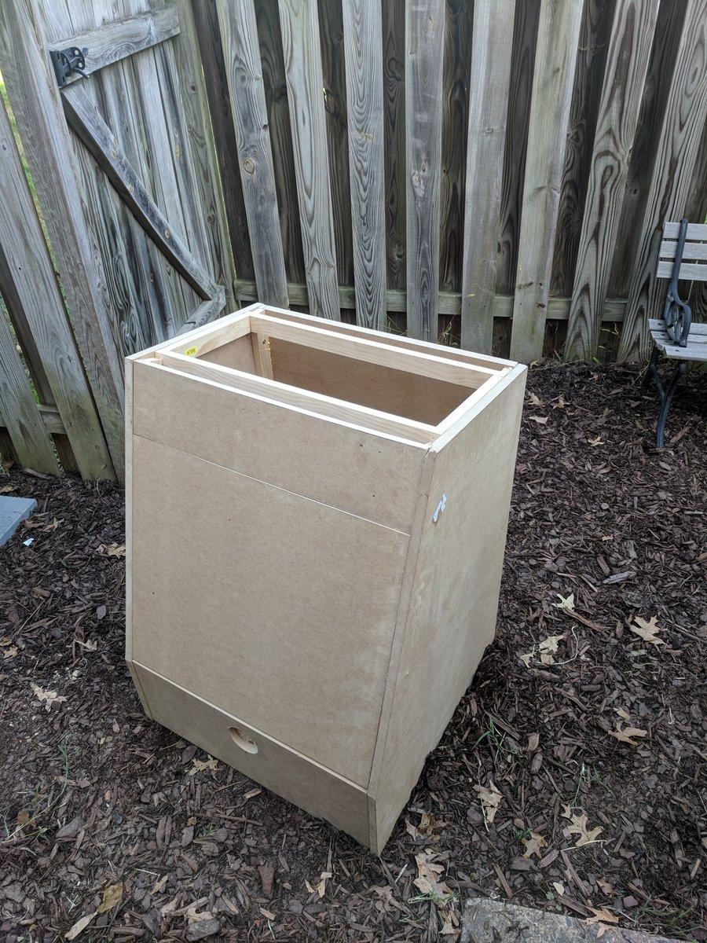
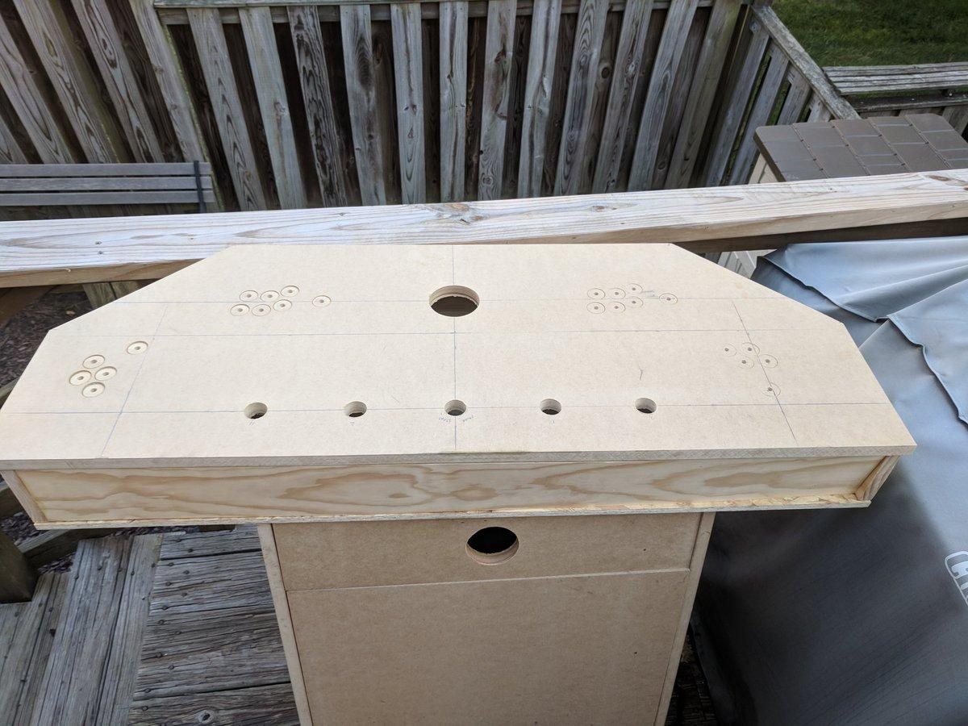
Build a pedestal

Slide 4
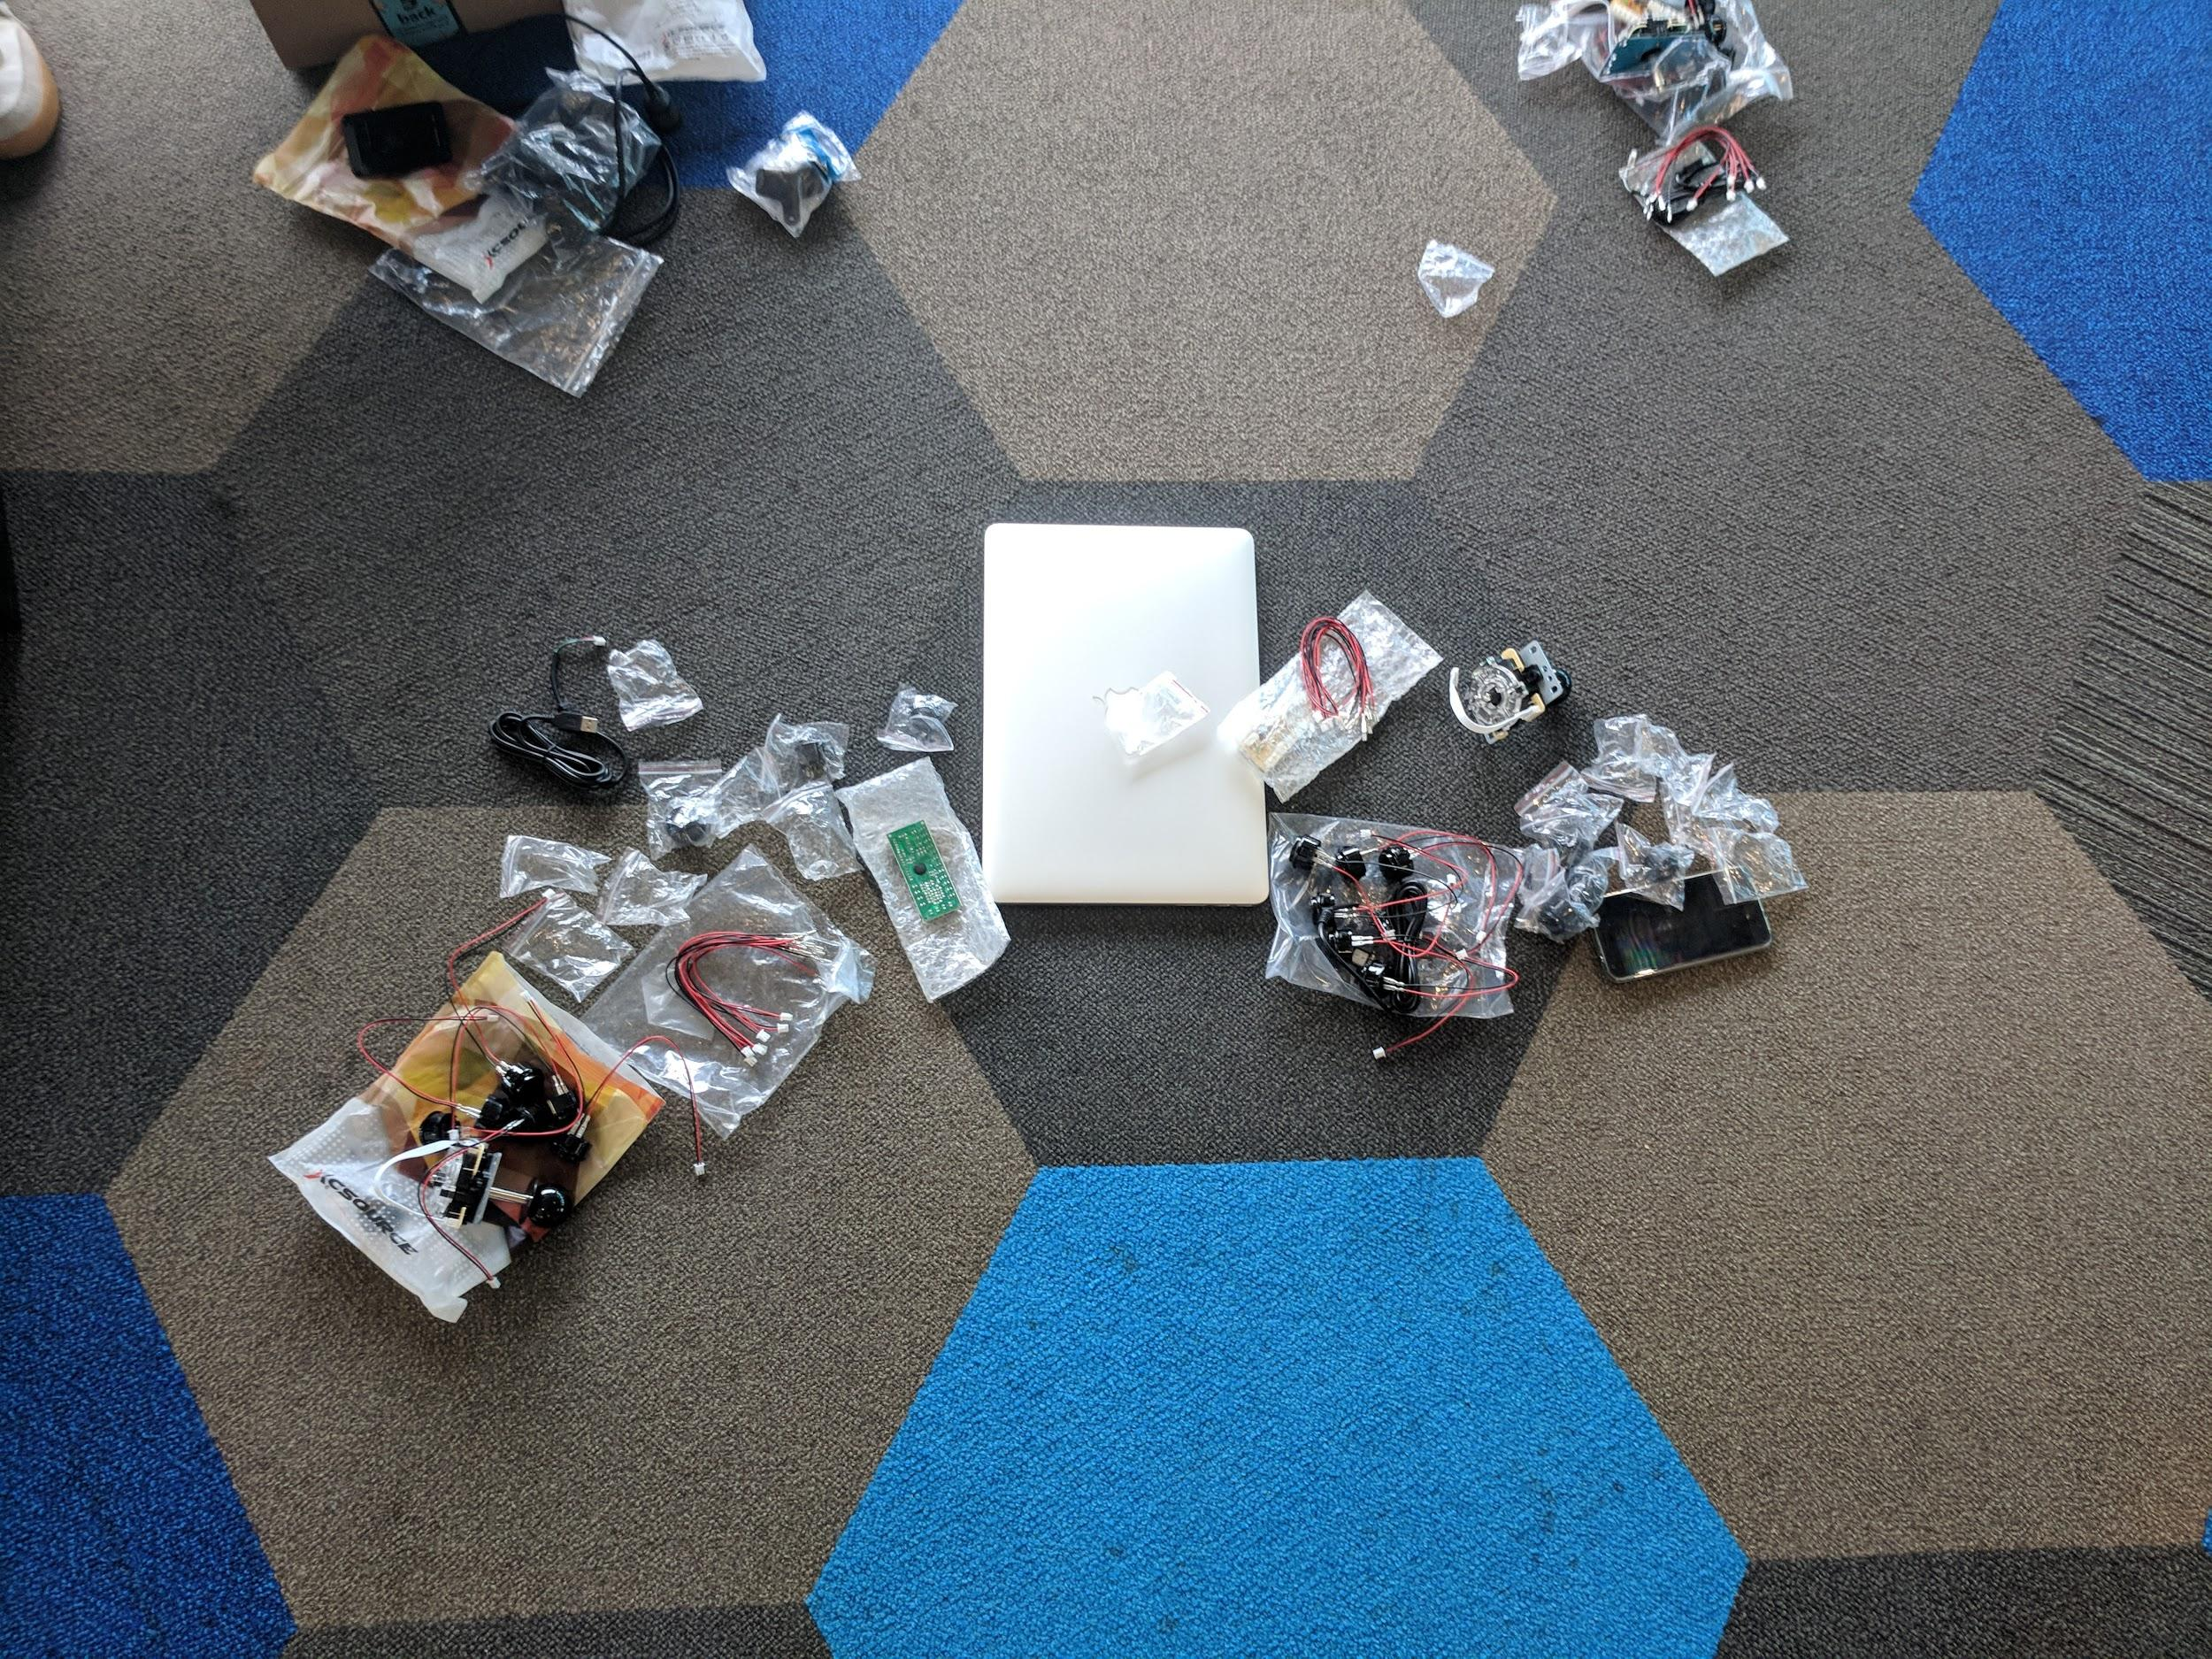
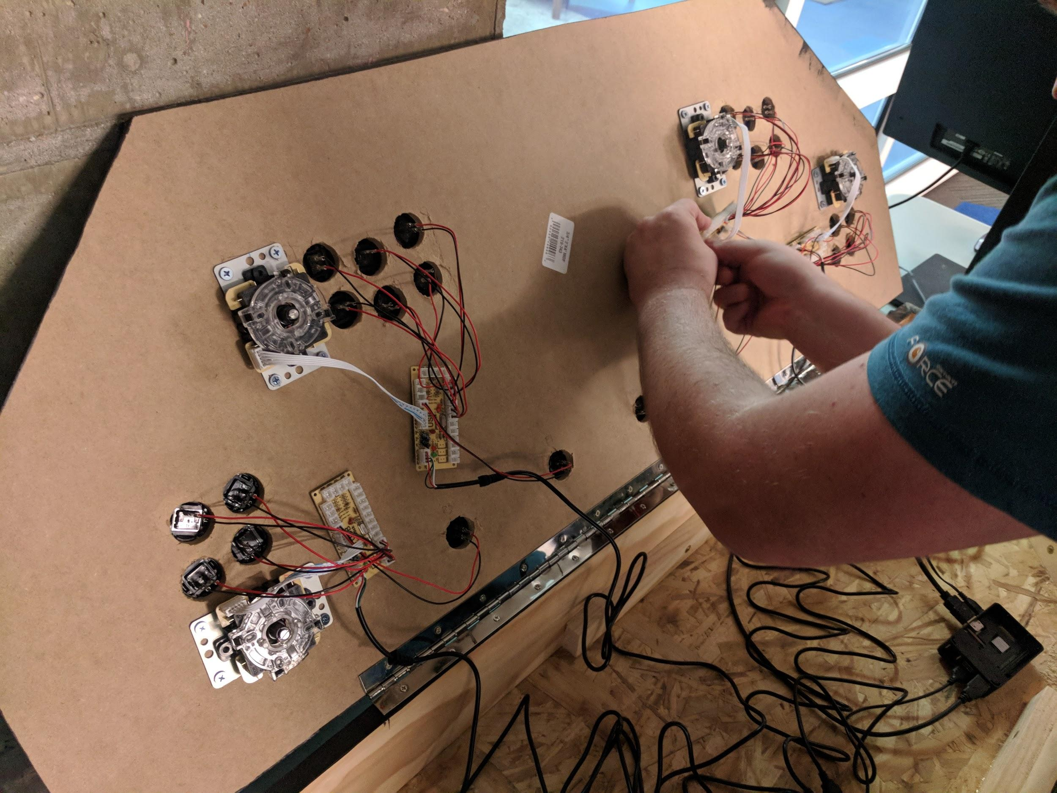
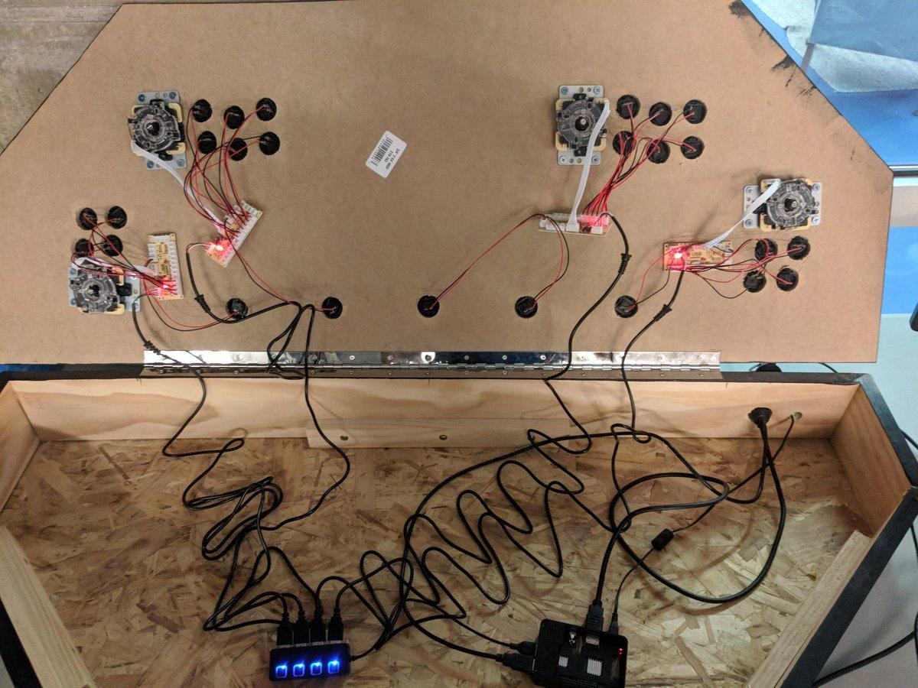
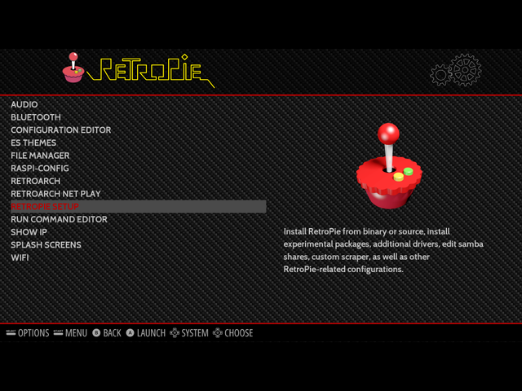
Configure RetroPie

Slide 5
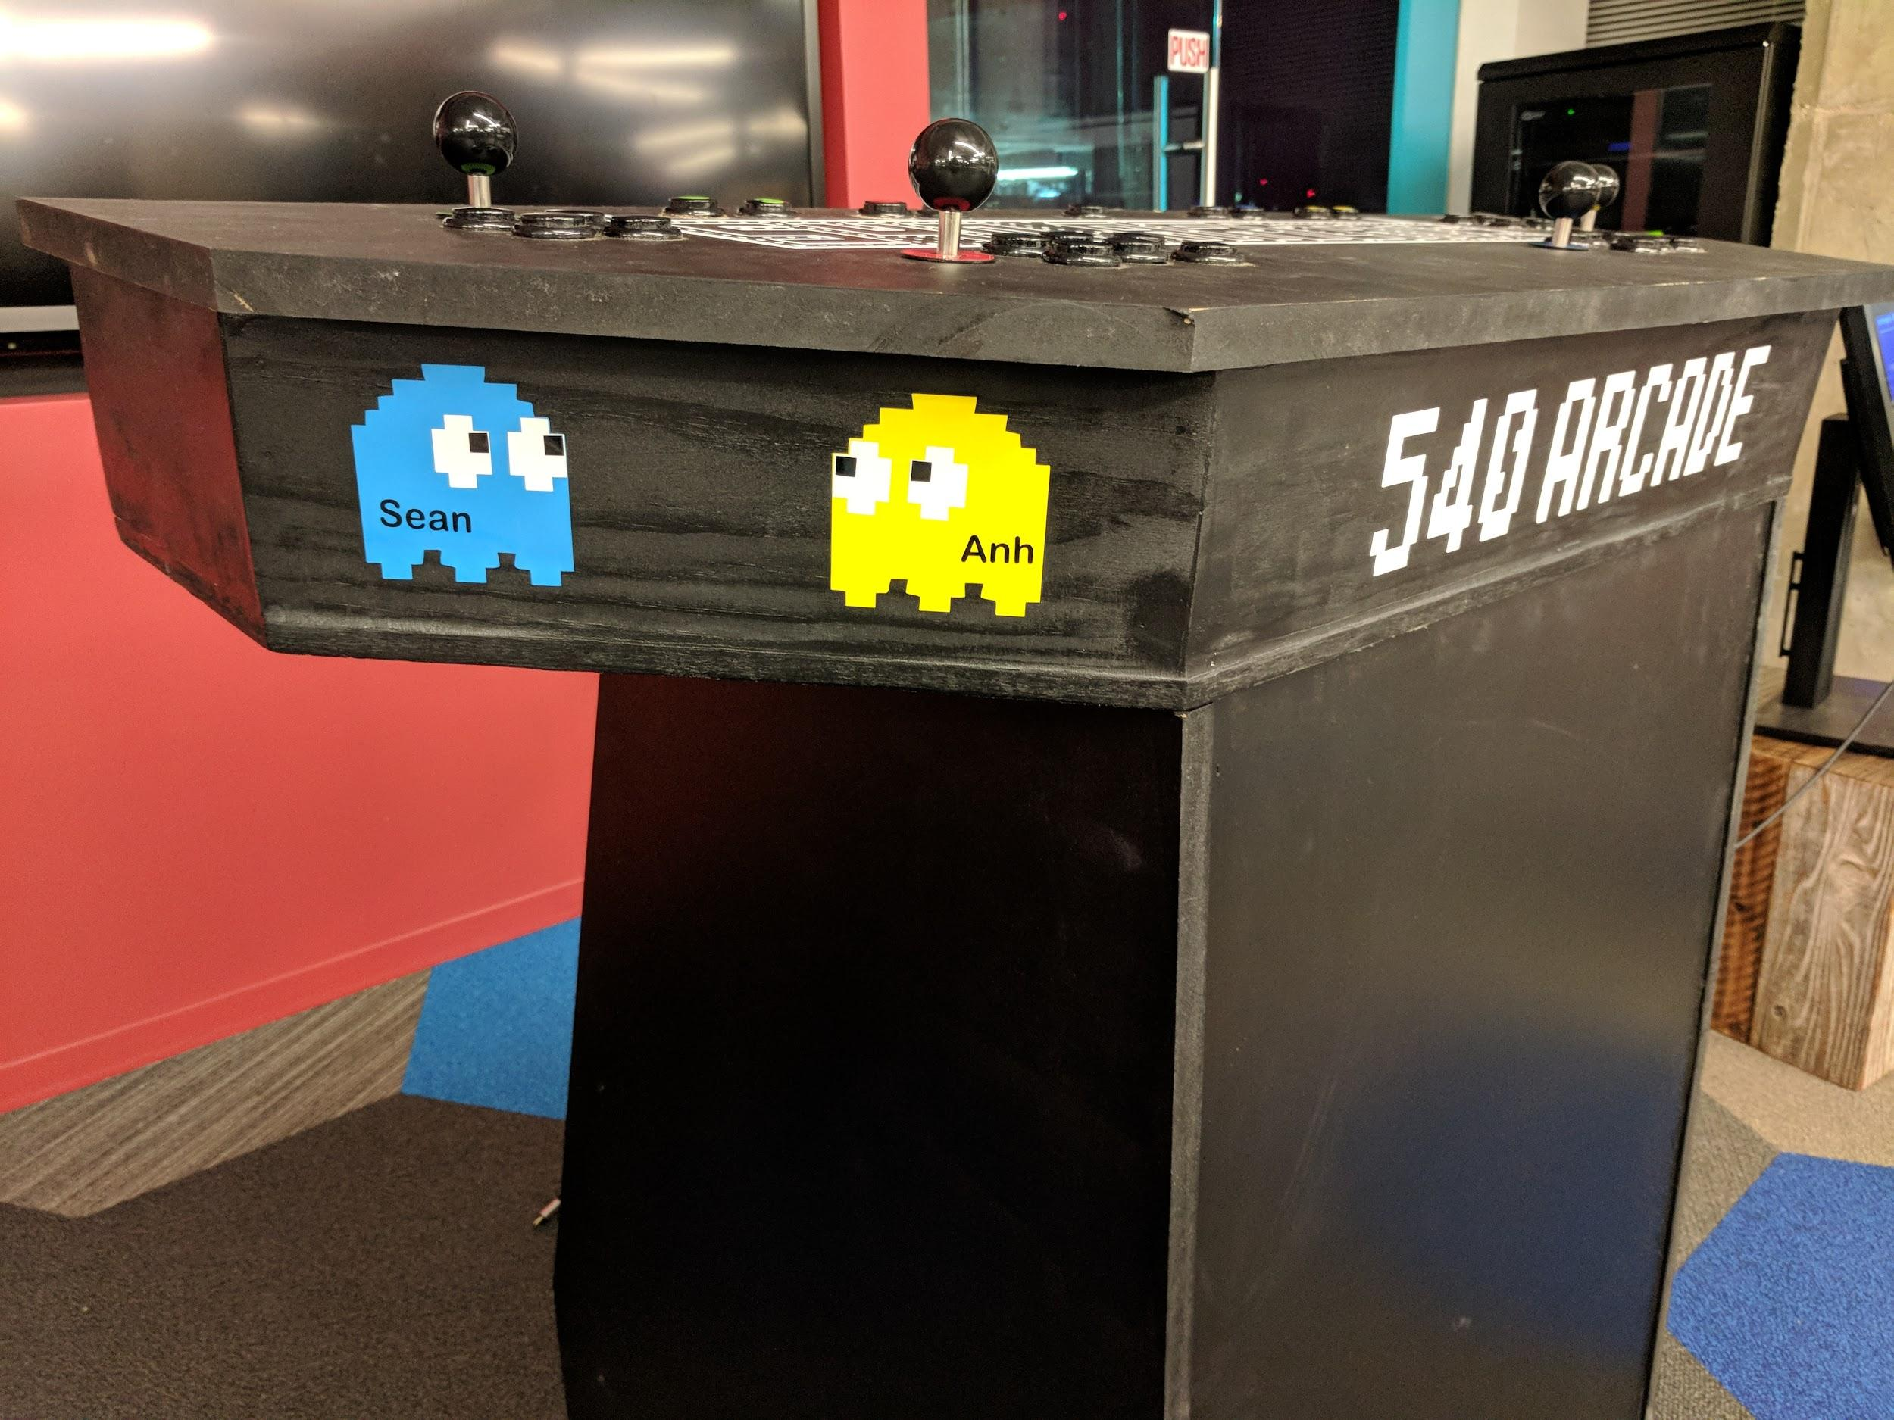
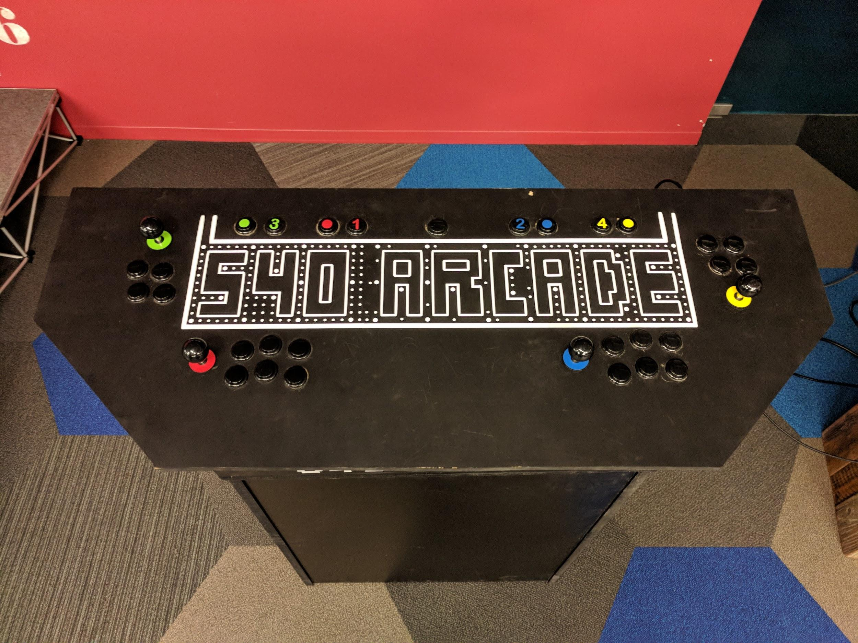
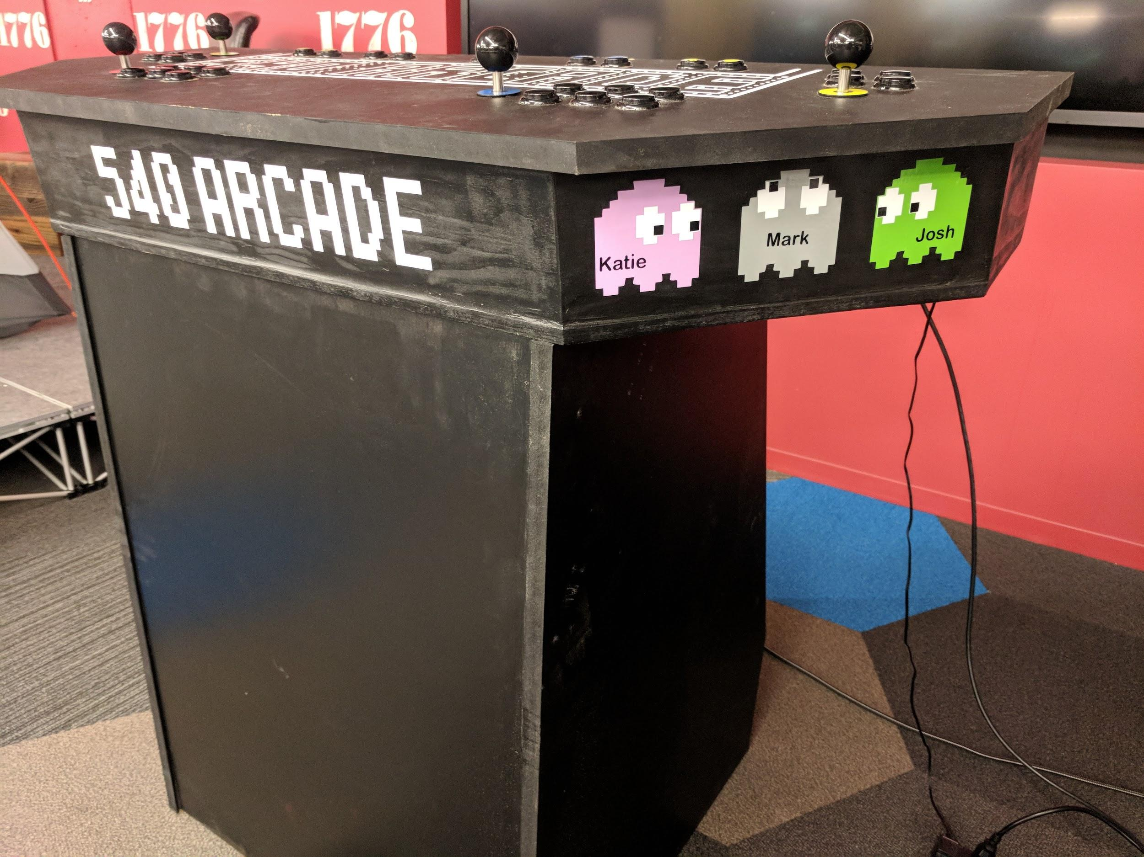
Final Design

Slide 6
Future Considerations
Add track ball
USB controller support
Different button configurations
Mobile transportation
Documentation

Slide 7
Lessons Learned
Initial Build
Tons of angled cuts and different/unknown measurements
Learning Curve
Configuring RetroPie and controls took more effort than expected
MAME Emulator
Difference between multiple emulators and supported ROMs

Slide 8
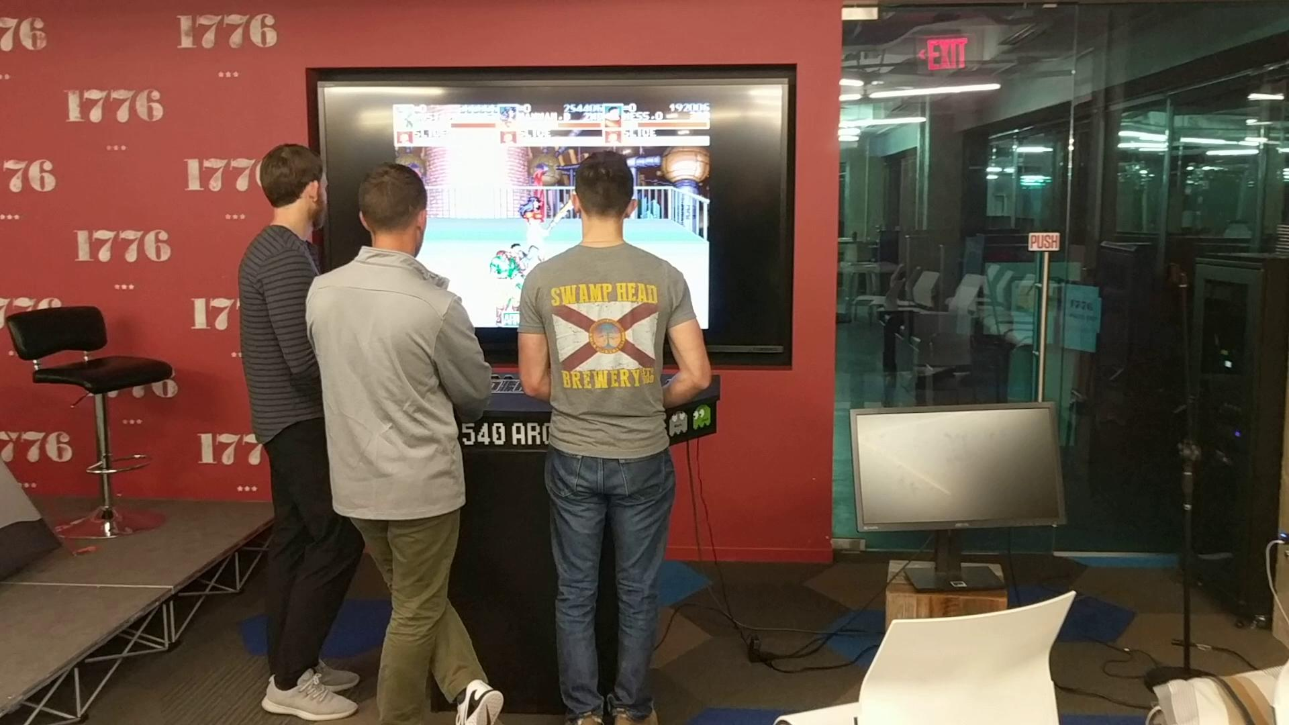
Proof!

Slide 9
Questions?

Slide 10
Features
Supports 4 Players
18 ROMs (Games)
Multiple emulators
Unlimited FUN!

